Slide 1
UNIT 3 Cyber Offences and Countermeasures
`

Slide 2
Overview of Firewalls

Slide 3
What is firewall
A Firewall is a network security device that monitors and filters incoming and outgoing network traffic based on an organization’s previously established security policies
A firewall is essentially the barrier that sits between a private internal network and the public Internet.
A firewall’s main purpose is to allow non-threatening traffic in and to keep dangerous traffic out.

Slide 4
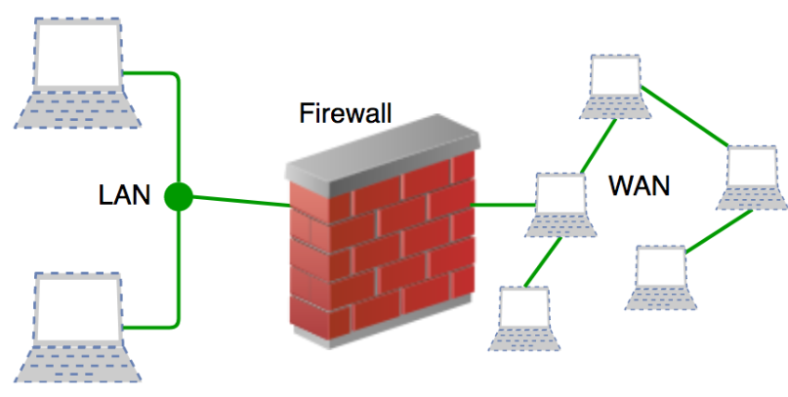

Slide 5
History
Firewalls have existed since the late 1980’s and started out as packet filters, which were networks set up to examine packets, or bytes, transferred between computers.
Packet filtering firewalls are still in use today, firewalls have come a long way as technology has developed throughout the decades.

Slide 6
Gen 1 Virus
Generation 1, Late 1980’s, virus attacks on stand-alone PC’s affected all businesses and group anti-virus products.
Gen 2 Networks
Generation 2, Mid 1990’s, attacks from the internet affected all business and drove creation of the firewall.
Gen 3 Applications
Generation 3, Early 2000’s, exploiting vulnerabilities in applications which affected most businesses and set Intrusion Prevention Systems Products (IPS).
Gen 4 Payload
Generation 4, Approx. 2010, rise of targeted, unknown, evasive, polymorphic attacks which affected most businesses and drove anti-bot and sandboxing products.
Gen 5 Mega
Generation 5, Approx. 2017, large scale, multi-vector, mega attacks using advance attack tools and is driving advance threat prevention solutions.

Slide 7
First-Generation Vs Modern Firewalls
Expanded Capabilities:
Next-generation firewalls (NGFWs) are sophisticated and integrate a number of network security components, including intrusion prevention systems (IPS), sandbox content analysis, and more.
It enables them to detect and respond to a greater range of potential threats.
Multiple Deployment Options:
Firewalls as either hardware firewalls – standalone appliances running on dedicated hardware .
OS software firewalls like those integrated into Windows, Linux, and macOS.
Modern firewalls are available in a variety of different form factors, enabling users to deploy them on-premises as physical appliances,
In the cloud as virtual appliances and as a firewall as a service (FWaaS) model.

Slide 8
What Firewalls Do?
A Firewall is a necessary part of any security architecture and takes the estimation out of host level protections and entrusts them to your network security device.
Firewalls, and especially Next Generation Firewalls, focus on blocking malware and application-layer attacks, along with an integrated intrusion prevention system (IPS)
Next Generation Firewalls can react quickly and to detect and react to outside attacks across the whole network.
Set policies to better defend your network and carry out quick assessments to detect offensive or suspicious activity, like malware, and shut it down.

Slide 9
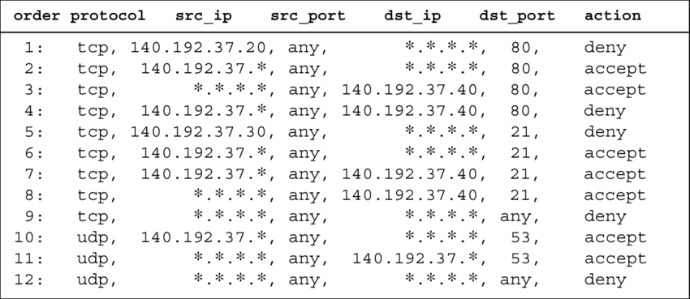
A firewall policy example.
Notes:
https://help.deepsecurity.trendmicro.com/10/0/Protection-Modules/Firewall/create-firewall-rules.html

Slide 10
Functions and Capabilities
Today’s firewalls, including Next Generation Firewalls and Network Firewalls support a wide variety of functions and capabilities with built-in features, including:
Network Threat Prevention
Application and Identity-Based Control
Hybrid Cloud Support
Scalable Performance
Network Traffic Management and Control
Access Validation
Record and Report on Events

Slide 11
What are the Components of Firewall Management?
Graphical Interface.
Policy Control
Threat Management
Device Management
Third-Party Integrations
Scalability

Slide 12
Types of Firewalls
1.Packet filtering
A small amount of data is analyzed and distributed according to the filter’s standards.
2.Proxy service or Circuit level Gateway
Network security system that protects while filtering messages at the application layer.
3.Application level Gateway
It operates at the application level. Multiple application gateways can run on the same host but each gateway is a separate server with its own processes.
4.Stateful inspection
Dynamic packet filtering that monitors active connections to determine which network packets to allow through the Firewall.
5.Next Generation Firewall (NGFW)
Deep packet inspection Firewall with application-level inspection.

Slide 13
Packet-filtering firewalls
Definition:-A packet filtering firewall examines individual network packets and decides whether to allow or block them based on predefined rules.
Packet-filtering firewalls operate at the network layer . Packet-filtering firewalls make processing decisions based on network addresses, ports, or protocols.
Packet-filtering firewalls are very fast
Do not do any internal inspection of the traffic.
Do not store any state information.
Packet-filtering firewalls are considered not to be very secure. This is because they will forward any traffic that is flowing on an approved port.
So there could be malicious traffic being sent, but as long as it’s on an acceptable port, it will not be blocked.

Slide 14
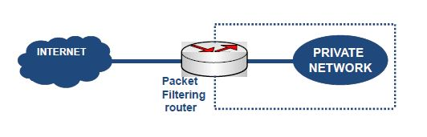

Slide 15
Proxy service
Definition:- A proxy firewall acts as an intermediary between the internal user and the external server.
A proxy firewall is a network security system that protects network resources by filtering messages at the application layer.
A proxy firewall is also be called an application firewall or circuit level gateway firewall.
A proxy firewall is also a proxy server, but not all proxy servers are proxy firewalls. A proxy server acts as an intermediary between clients and servers. It can cache WebPages to reduce bandwidth demands, compress data, filter traffic and detect viruses.
A Proxy server can also be used to hide user information or to connect to services that would be blocked.
A proxy firewall inspects all network traffic to detect and protect against potential threats.
It can also detect network intrusion and enforce security policies.

Slide 16
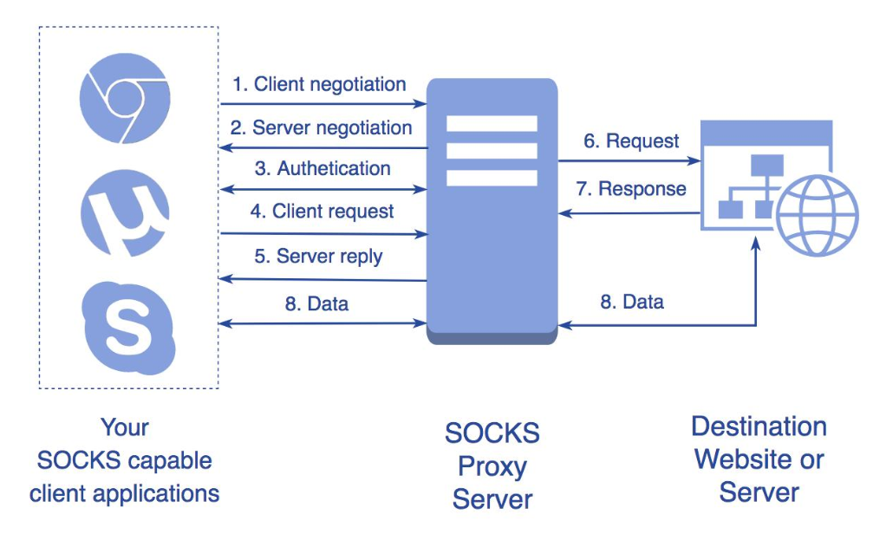

Slide 17
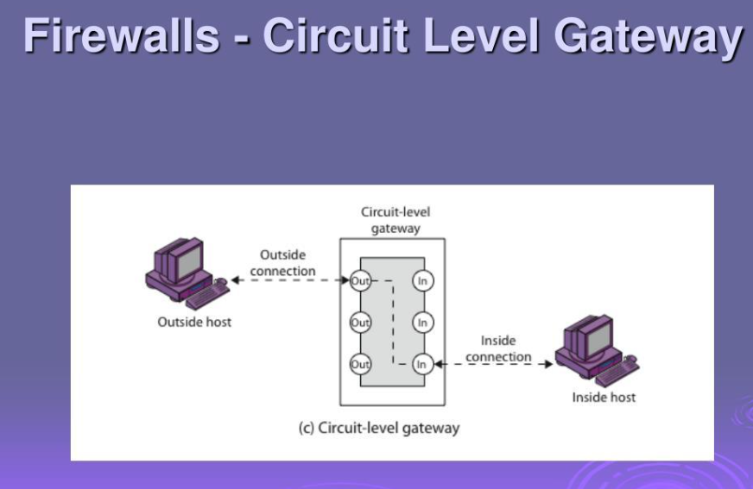

Slide 18
Application-level Gateway
Definition:-An application-level gateway, also called an application proxy firewall, operates at the Application Layer (Layer 7).
It understands specific applications and protocols such as:
HTTP/HTTPS
FTP
SMTP
DNS
It can inspect the actual application request.
Application-level gateway is also called a bastion host. It operates at the application level. Multiple application gateways can run on the same host but each gateway is a separate server with its own processes.
These firewalls, also known as application proxies, provide the most secure type of data connection because they can examine every layer of the communication, including the application data.
Example: Consider FTP service.
It works as follows:
Step-1: User contacts the application gateway using a TCP/IP application such as HTTP.
Step-2: The application gateway asks about the remote host with which the user wants to establish a connection. It also asks for the user id and password that is required to access the services of the application gateway.
Step-3: After verifying the authenticity of the user, the application gateway accesses the remote host on behalf of the user to deliver the packets.

Slide 19
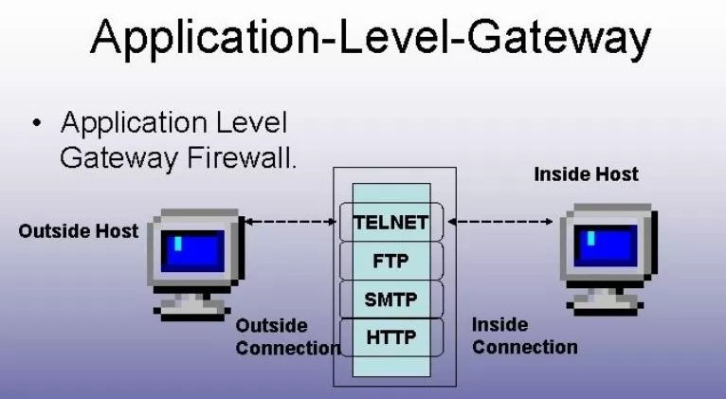

Slide 20
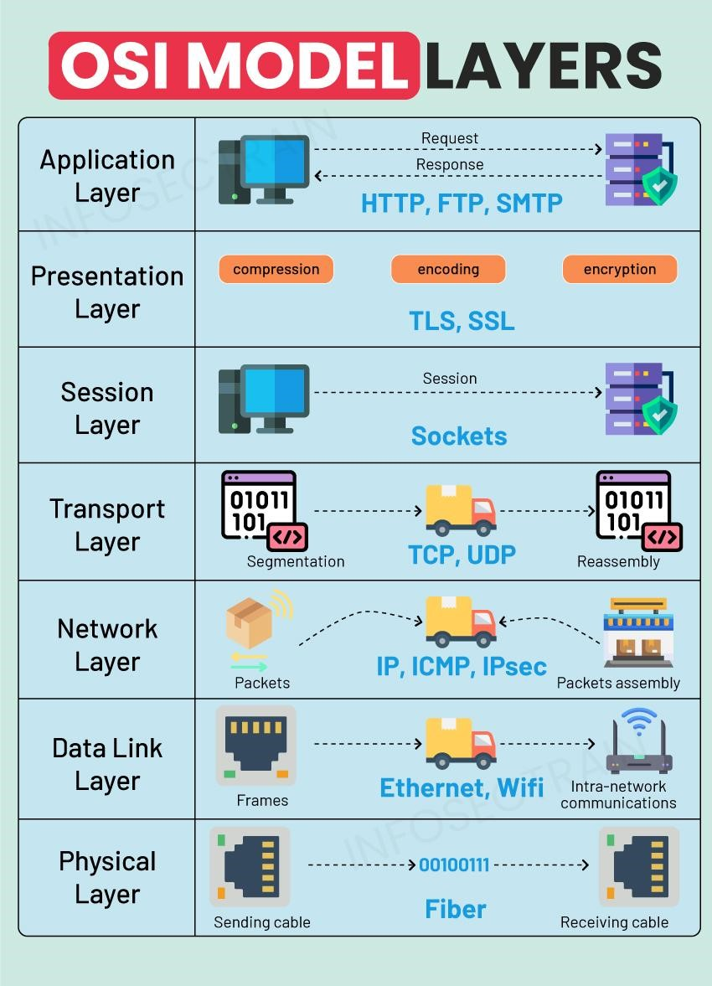

Slide 21
Stateful inspection
Definition:- A stateful firewall does not examine each packet independently.Instead, it keeps track of active network connections.It maintains something called a state table.
For example:
Source IP Source Port Destination IP Dest Port State
192.168.1.10 5000 8.8.8.8 443 ESTABLISHED
The firewall knows that this connection is already legitimate.
Stateful Inspection Firewall – a technology that controls the flow of traffic between two or more networks.
SI Firewalls track the state of sessions and dropping packets that are not part of a session allowed by a pre-defined security policy.
This is sometimes called session-level protection because they keep state information for each network session and make allowed/denied decisions based on a session state table.
SI firewalls go beyond individual transmission control protocol (TCP) connections to involve many such connections.
SI firewalls support dynamic protocols by identifying port change instructions in client-server communication and comparing future sessions against these negotiated ports.
For instance, to track fire transfer protocol (FTP) sessions, the firewall inspects the control connection, used for issuing commands and negotiating dynamic ports, and then allows in various data connections for transferring files.

Slide 22
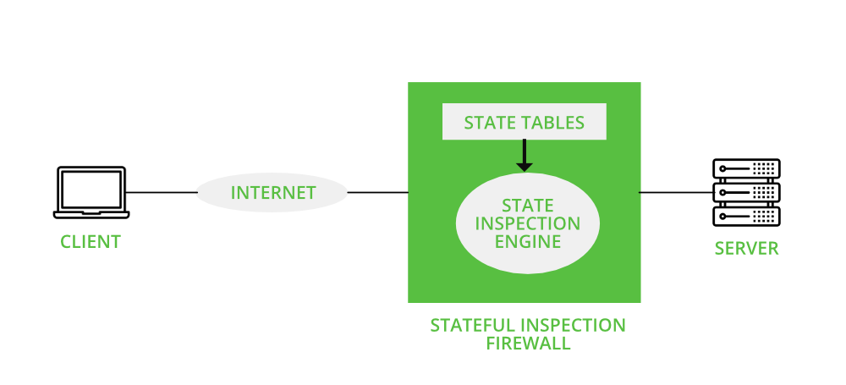

Slide 23
Countermeasures in Cyber Security
Definition:-Countermeasures are the security measures, techniques, policies, and controls implemented to prevent, detect, minimize, or recover from cyber attacks and security threats.
Objectives of Countermeasures
Prevent unauthorized access.
Protect sensitive data.
Detect cyber attacks quickly.
Minimize the impact of security incidents.
Ensure business continuity.
Maintain the confidentiality, integrity, and availability (CIA) of information.

Slide 24
Types of Countermeasures
1. Preventive Countermeasures
These measures stop attacks before they occur.
Examples:
Strong passwords
Multi-Factor Authentication (MFA)
Firewalls
Antivirus software
Data encryption
Security awareness training

Slide 25
2. Detective Countermeasures
These measures identify attacks or suspicious activities.
Examples:
Intrusion Detection Systems (IDS)
Security monitoring
Log analysis
Vulnerability scanning
Security audits

Slide 26
3. Corrective Countermeasures
These measures reduce damage and restore systems after an attack.
Examples:
Restoring data from backups
Removing malware
Applying security patches
Resetting compromised passwords
Recovering affected systems

Slide 27
Common Cyber Security Countermeasures
Countermeasure | Purpose
Firewall | Blocks unauthorized network access.
Antivirus Software | Detects and removes malware.
Multi-Factor Authentication (MFA) | Adds an extra layer of login security.
Encryption | Protects data from unauthorized access.
Regular Software Updates | Fixes security vulnerabilities.
Backup and Recovery | Restores data after attacks or failures.
Intrusion Detection System (IDS) | Detects suspicious activities.
Intrusion Prevention System (IPS) | Detects and blocks attacks automatically.
Access Control | Restricts access to authorized users only.
Security Awareness Training | Educates users about cyber threats.

Slide 28
Example
Scenario: An attacker sends a phishing email containing malware.
Countermeasures:
Email filtering blocks the malicious email.
Antivirus detects and removes the malware.
Employee awareness training helps users recognize phishing attempts.
MFA prevents account compromise even if a password is stolen.
Data backups allow recovery if files are affected.

Slide 29
Benefits of Countermeasures
Reduce cyber security risks.
Protect confidential information.
Prevent financial losses.
Improve system availability.
Ensure compliance with security regulations.
Increase user confidence and trust.

Slide 30
Best Practices
Use strong, unique passwords.
Enable Multi-Factor Authentication (MFA).
Keep operating systems and applications updated.
Perform regular data backups.
Install antivirus and firewall protection.
Monitor network activity continuously.
Conduct periodic security audits.
Train employees on cybersecurity best practices.

Slide 31
Configuration of Firewalls
Introduction
A firewall is a network security device or software that monitors and controls incoming and outgoing network traffic based on predefined security rules.
Proper firewall configuration helps protect computers and networks from unauthorized access, malware, and cyber attacks.

Slide 32
Steps in Firewall Configuration
1. Define Security Policy
Identify which services and applications are allowed.
Determine which traffic should be blocked.
Establish security requirements for the organization.
Example:
Allow HTTP (Port 80) and HTTPS (Port 443).
Block unnecessary ports such as Telnet (Port 23).
2. Choose the Firewall Type
Select an appropriate firewall based on organizational needs.
Packet Filtering Firewall
Stateful Inspection Firewall
Proxy Firewall
Next-Generation Firewall (NGFW)

Slide 33
3. Configure Network Interfaces
Assign firewall interfaces to different network zones.
Example:
Internal Interface (LAN): Trusted network
External Interface (WAN): Internet connection
DMZ Interface: Public-facing servers
4. Configure Firewall Rules
Create rules that define which traffic is allowed or denied.
Rule Components:
Source IP address
Destination IP address
Protocol (TCP/UDP/ICMP)
Port number
Action (Allow or Deny)

Slide 34
Example Rules
Rule | Source | Destination | Port | Action
1 | Any | Web Server | 80 | Allow
2 | Any | Web Server | 443 | Allow
3 | Any | Internal Network | 23 | Deny
4 | Internal Network | Internet | 53 | Allow

Slide 35
5. Configure Network Address Translation (NAT)
Hide internal IP addresses.
Allow multiple devices to share a public IP address.
Protect internal network information.
6. Enable Logging and Monitoring
Record allowed and blocked traffic.
Monitor suspicious activities.
Generate security alerts.
7. Enable Intrusion Detection/Prevention (Optional)
Some firewalls include:
Intrusion Detection System (IDS)
Intrusion Prevention System (IPS)
These features detect and block known cyber attacks.

Slide 36
8. Test Firewall Rules
Verify that:
Authorized traffic is allowed.
Unauthorized traffic is blocked.
Applications function correctly.
Common testing tools:
Ping
Nmap
Telnet
Packet analyzers (e.g., Wireshark)
9. Regular Maintenance
Update firewall firmware and software.
Review firewall rules periodically.
Remove unused or outdated rules.
Back up the firewall configuration.
Monitor security logs regularly

Slide 37
Firewall Configuration Best Practices
Follow the principle of least privilege (allow only necessary traffic).
Change default administrator usernames and passwords.
Disable unused services and ports.
Allow only required inbound connections.
Restrict remote administration.
Enable logging and regular monitoring.
Keep firewall software updated.
Test firewall rules after every configuration change

Slide 38
Example Firewall Configuration
Service | Port | Protocol | Action
HTTP | 80 | TCP | Allow
HTTPS | 443 | TCP | Allow
DNS | 53 | UDP/TCP | Allow
SSH | 22 | TCP | Allow (Administrators Only)
FTP | 21 | TCP | Deny (If Not Required)
Telnet | 23 | TCP | Deny
All Other Traffic | Any | Any | Deny

Slide 39
Advantages of Proper Firewall Configuration
Prevents unauthorized access.
Protects against malware and cyber attacks.
Controls network traffic.
Improves network security.
Helps ensure compliance with security policies.
Provides logging and auditing for incident analysis.

Slide 40
Proxy Servers and Anonymizers
Introduction
In modern computer networks, users often require security, privacy, and controlled Internet access.
Proxy servers and anonymizers help achieve these goals by acting as intermediaries between users and Internet resources. They improve security, protect user identity, and help organizations monitor and manage web traffic.

Slide 41
Proxy Server
Definition
A proxy server is a computer or software that acts as an intermediary between a client and a destination server. It receives requests from clients, processes them, and forwards them to the appropriate web server.
Definition:
A proxy server is an intermediary server that receives client requests and forwards them to the destination server while providing security, caching, and access control.
Working of a Proxy Server
A client sends a request to access a website.
The request is received by the proxy server.
The proxy checks the request against security policies.
If permitted, the proxy forwards the request to the destination server.
The destination server sends the response to the proxy.
The proxy forwards the response back to the client.

Slide 42
Functions of a Proxy Server
Hides the client's IP address.
Filters Internet traffic.
Blocks unauthorized websites.
Caches frequently accessed web pages.
Improves browsing speed.
Monitors and logs user activity.
Enhances network security

Slide 43
Types of Proxy Servers
1. Forward Proxy
Represents clients.
Used to access Internet resources securely.
2. Reverse Proxy
Represents servers.
Protects web servers and balances incoming traffic.
3. Transparent Proxy
Intercepts traffic without changing client settings.
Commonly used for web filtering and caching.
4. Anonymous Proxy
Hides the client's IP address while identifying itself as a proxy.
5. High-Anonymity (Elite) Proxy
Completely hides the client's identity and the use of a proxy

Slide 44
Advantages and Disadvantages of Proxy Servers
Advantages
Enhances security.
Provides web filtering.
Improves performance through caching.
Hides client IP addresses.
Reduces bandwidth usage.
Monitors Internet usage.
Disadvantages
May slow network performance.
Incorrect configuration can create security risks.
Free proxies may not be trustworthy.
Some websites block proxy traffic.

Slide 45
Anonymizers
Definition
An anonymizer is a service or software that hides a user's identity by masking the user's IP address while accessing websites.
Working of an Anonymizer
The user connects to an anonymizer.
The anonymizer replaces the user's IP address with its own.
The request is forwarded to the destination website.
The website responds to the anonymizer.
The anonymizer sends the response back to the user.

Slide 46
Features of Anonymizers
Hide the user's IP address.
Protect user privacy.
Prevent online tracking.
Provide anonymous web browsing.
Help bypass geographic restrictions (where permitted).
Advantages of Anonymizers
Protect online privacy.
Hide user identity.
Reduce tracking by websites.
Increase anonymity.
Improve browsing privacy.
Disadvantages of Anonymizers
Can reduce Internet speed.
Some websites block anonymous users.
Free services may collect user data.
Do not guarantee complete anonymity.

Slide 47
Difference Between Proxy Server and Anonymizer
Proxy Server | Anonymizer
Acts as an intermediary for network communication. | Focuses on hiding the user's identity.
Used for security, filtering, and caching. | Used mainly for privacy and anonymous browsing.
May or may not hide the user's IP address. | Always attempts to hide the user's IP address.
Frequently used by organizations. | Commonly used by individuals.

Slide 48
Applications
Secure web browsing
Internet access control
Website caching
Network monitoring
Anonymous browsing
Privacy protection
Content filtering

Slide 49
VPN Security
Introduction
A Virtual Private Network (VPN) is a technology that creates a secure and encrypted connection over a public network such as the Internet. VPN security protects data from unauthorized access by encrypting communication between users and the destination network, ensuring secure remote access and private communication.
Definition
VPN Security refers to the methods and technologies used to protect data transmitted through a Virtual Private Network by providing confidentiality, integrity, authentication, and privacy.

Slide 50
Need for VPN Security
VPN security is important because it:
Protects sensitive information during transmission.
Prevents unauthorized access to private networks.
Secures communication over public Wi-Fi.
Enables secure remote access for employees.
Maintains user privacy by hiding IP addresses.
Reduces the risk of eavesdropping and data theft.

Slide 51
How VPN Security Works
The user connects to a VPN server.
The VPN client authenticates the user.
A secure encrypted tunnel is established.
All data is encrypted before transmission.
The encrypted data travels through the Internet.
The VPN server decrypts the data and forwards it to the destination.
Responses follow the same secure path back to the user.

Slide 52
Key Security Features of VPN
1. Encryption
Converts readable data into unreadable ciphertext.
Prevents attackers from reading intercepted data.
2. Authentication
Verifies the identity of users and VPN servers.
Prevents unauthorized access.
3. Data Integrity
Ensures that transmitted data is not altered.
Detects tampering during transmission.
4. Confidentiality
Protects sensitive information from unauthorized disclosure.
5. IP Address Masking
Hides the user's real IP address.
Enhances online privacy.
6. Secure Tunneling
Creates an encrypted tunnel between the client and the VPN server.
Protects data while it travels over the Internet.

Slide 53
VPN Protocols
Protocol | Features
PPTP | Easy to configure but offers lower security.
L2TP/IPsec | Combines tunneling with strong encryption.
OpenVPN | Highly secure, open-source, and widely used.
IKEv2/IPsec | Fast, secure, and stable, especially for mobile devices.
WireGuard | Modern VPN protocol with high performance and strong security.

Slide 54
Types of VPN
1. Remote Access VPN
Connects individual users securely to a private network.
Commonly used by remote employees.
2. Site-to-Site VPN
Connects two or more office networks securely over the Internet.
Used by organizations with multiple branches.
3. Client-to-Site VPN
Allows a user's device to securely connect to a corporate network.
Advantages of VPN Security
Protects confidential data.
Encrypts Internet traffic.
Secures remote access.
Hides the user's IP address.
Reduces the risk of cyber attacks on public networks.
Enables secure communication between branch offices.
Improves privacy while browsing.

Slide 55
Limitations of VPN Security
May reduce Internet speed due to encryption.
Requires proper configuration and management.
Does not protect against malware already on the device.
Some websites or services may block VPN traffic.
Free VPN services may provide weaker security or log user activity.

Slide 56
Applications of VPN
Remote work
Corporate network access
Secure online banking
Public Wi-Fi protection
Secure communication between branch offices
Privacy-focused Internet browsing
Example
A company employee working from home needs to access the organization's internal server.
The employee connects to the company's VPN.
A secure encrypted tunnel is created.
All communication between the employee and the company network is encrypted.
Even if the data is intercepted, it cannot be read without the encryption key.

Slide 57
Best Practices for VPN Security
Use strong authentication (preferably Multi-Factor Authentication).
Choose secure protocols such as OpenVPN, IKEv2/IPsec, or WireGuard.
Keep VPN software updated.
Use strong passwords.
Disconnect the VPN when it is no longer needed.
Avoid using untrusted or free VPN services for sensitive work.

Slide 58
Course Outcomes (COs)
Upon completion of course the students will be able to
analyze cyber offences and implement effective countermeasures

